Slide 1
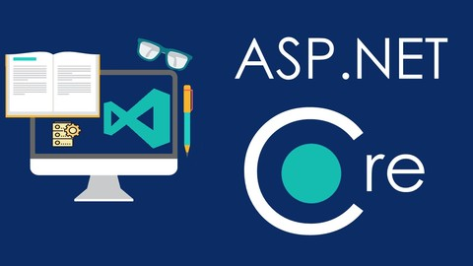
ASP.NET Core Introduction
ASP.NET Core, MVC, Controllers & Actions​,
Creating an ASP.NET Core MVC app
SoftUni Team
Technical Trainers
Software University
https://softuni.bg

Slide 2
Table of Content
ASP.NET Core
MVC Pattern
ASP.NET Core MVC
Creating an ASP.NET Core MVC App
Controllers and Actions
Routing
Static Files
MVC Views and Razor
Dependency Injection
Model Binding
Model Validation

Slide 3
Questions?
sli.do
#csharp-web

Slide 4
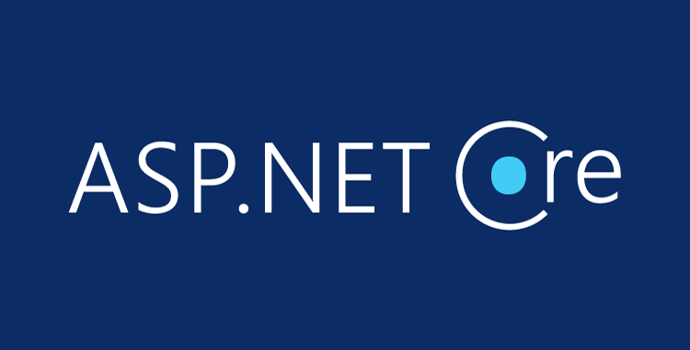
ASP.NET Core
Overview

Slide 5
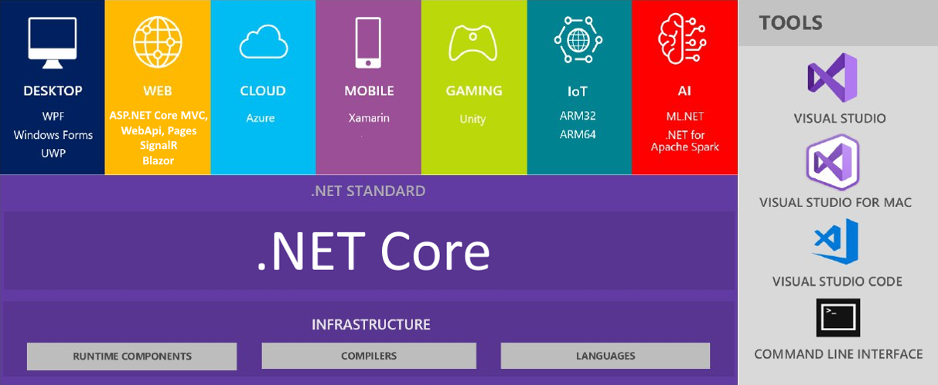
.NET Core: Bird's Eye View

Slide 6
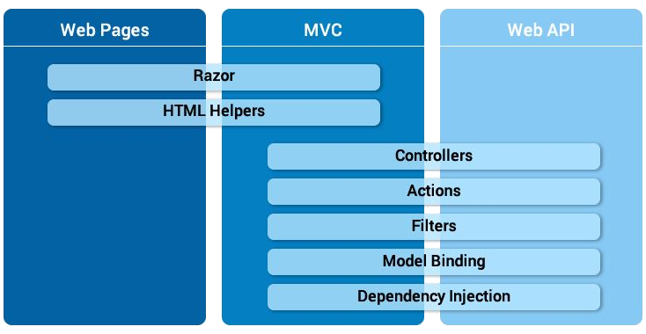
ASP.NET Core Overview (1)
ASP.NET Core is a cross-platform open-source back-end development framework for C#
ASP.NET Core MVC: build server-side Web apps
ASP.NET Core Web API: build Web services and REST APIs
ASP.NET Core Web Pages: build simple Web apps

Slide 7
ASP.NET Core Overview (2)
Great documentation: https://docs.microsoft.com/en-us/aspnet
ASP.NET Core provides:
Integration of modern client-side frameworks (Angular, Blazor, etc.)
Development workflows (MVC, WebAPI, Razor Pages, SignalR)
ASP.NET Core applications run both on .NET Core and .NET Framework

Slide 8
ASP.NET Core Main Features
A unified framework for building web UI and web APIs, architected for testability
Ability to develop and run on Windows, macOS and Linux
Ability to host on IIS, Nginx, Apache, Docker or self-host in your own process
Built-in dependency injection
A lightweight, high-performance and modular HTTP request pipeline (middlewares)
Razor Pages is a page-based programming model that makes building web UI easier
Blazor lets you use C# in the browser and share server-side and client-side app logic
Razor markup provides syntax for Razor Pages, MVC views and Tag Helpers
Cloud-ready, environment-based configuration system
Side-by-side app versioning
Tooling that simplifies modern web development (Visual Studio, VS Code, CLI)

Slide 9

The MVC Pattern

Slide 10
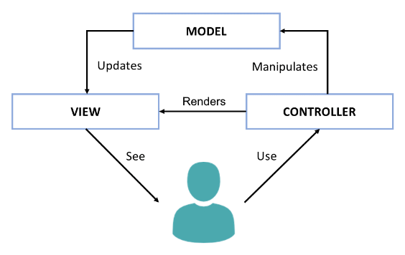
The Model-View-Controller (MVC) Pattern
The Model-View-Controller (MVC) pattern
Controller
Handles user actions
Updates the model
Renders the view (UI)
Model
Holds app data
View
Displays the UI, based on the model data
Notes:
Another important concept from software development is the Model-View-Controller (MVC) pattern.
MVC is an architectural pattern for structuring Web back-end apps,
by dividing their logic into 3 separate components: models, views and controllers.
The MVC pattern is illustrated at the diagram, which shows the interactions between the MVC components.
MVC is complex and some developers need time to understand it.
We shall spend significant time, effort and practical work to learn it, later at SoftUni.
But now, let's briefly explain the MVC pattern.
MVC splits the app into controllers, views and models.
Users interact with the controllers, which modify the data in the models and visualize the data using the views.
For example, let's take a phonebook app.
Users see the phonebook entries on the screen. They are rendered by a view component.
The app model holds the phonebook entries. This is the data model behind the views.
Controllers are responsible for handling the user actions, such as "view the phonebook", "search", and "add new entry".
The controllers, models and views are strongly interconnected, but each of them has well defined responsibility.
The idea of MVC is to build a better app structure, which simplifies development and improves maintenance.
The presentation logic, which displays elements on the screen is always located in the views.
The logic for user interaction, which handles the user input, is always located in the controllers.
The data models and data related logic are in the models.
The MVC app structure is very popular in Web back-end frameworks (such as ASP.NET MVC, Django and Spring MVC).
Variants of MVC sometimes are used in some Web front-end frameworks and mobile app frameworks.
In the MVC model, controllers handle user actions, such as clicking a button or choosing an item from a list.
Depending on the user action, controllers may update the app data model.
Then, controllers render a view (the user interface), which visualizes the data model.
For example, in our phonebook app, the phonebook controller handles the action "click on a phonebook entry".
The action handler loads the data about the selected phonebook entry into a data model object.
Then it shows a view, which displays this data object.
Models holds app data.
Typically models are data classes, which hold the data, that should be displayed at the screen.
For example, in our phonebook app, the data model, used to visualize a phonebook entry, is a data object, holding the phonebook entry details.
Views displays the UI for certain screen from the app, based on the data from the model.
For example, in our phonebook app, the view, which displays the phonebook entries,
takes as an input a data model, holding a list of phonebook entries.
The view iterates over the entries one by one and displays them in a table or list.
MVC is an important paradigm for structuring Web apps back-end developers should learn it.
At SoftUni, we teach MVC as part of the server-side Web development courses and modules.

Slide 11
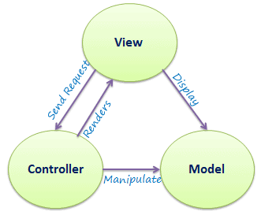
The MVC Pattern
Model–view–controller (MVC) is a software architectural pattern
Originally formulated in the late 1970s by Trygve Reenskaug as part of the Smalltalk (object-oriented programming language)
Code reusability and separation of concerns
Originally developed for desktop, then adapted for internet applications

Slide 12
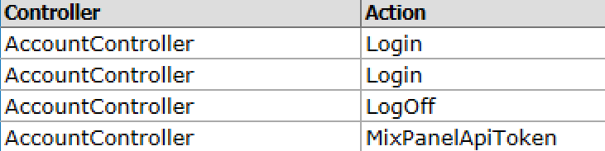
Controller
The Controller in MVC represents:
Processes user's actions and produces a response
Process the requests with the help of Views and Models
A set of classes that handles
Communication from the user
Overall application flow
Application-specific logic
Every Controller has one or more "Actions"

Slide 13
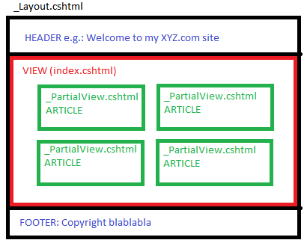
View
The View in MVC represents:
Defines how the application's user interface (UI) will be displayed
May support Master Views (layouts) and Sub-Views (partial views or controls)
In Web apps: template to dynamically generate HTML

Slide 14
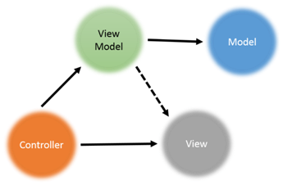
Model
The Model in MVC represents:
A set of classes that describes the data we display in the UI
May contain data validation rules
Two types of models
View model / binding model
Maps the UI of the Web page to C# class
Part of the MVC architecture
Database model / domain model
Maps database table to C# class (using ORM)

Slide 15
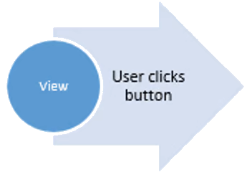
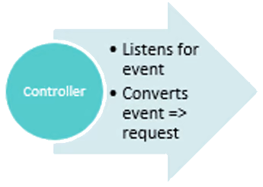
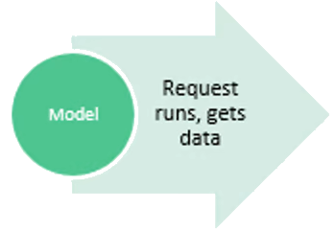
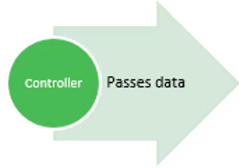
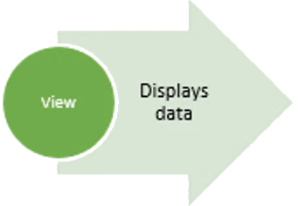
MVC Steps
Incoming Request routed to Controller
Controller processes Request and creates a Model (view model)
Controller also selects appropriate result (for example: View)
Model is passed to the View
The View transforms Model into appropriate output format (HTML)
Response is rendered (HTTP Response)

Slide 16

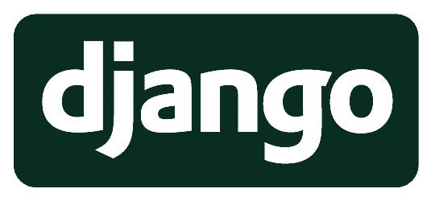
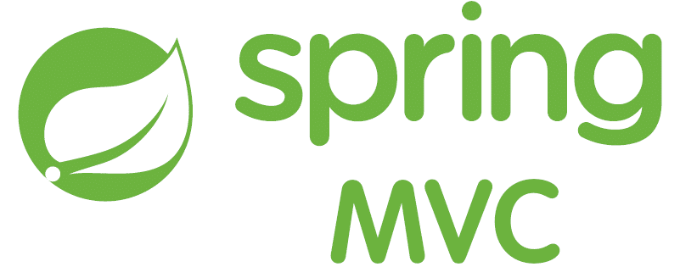

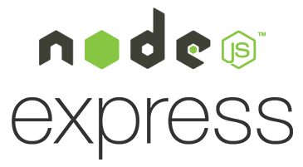
Web MVC Frameworks
Web MVC frameworks are used to build Web applications
It provides the MVC structure and engine to build Web apps
Controllers handle HTTP GET / POST requests and render a view
Views display HTML + CSS, based on the models
Models hold app data for views, prepared by controllers
Examples of Web MVC frameworks:
ASP.NET Core MVC (C#), Spring MVC (Java), Express (JS), Django (Python), Laravel (PHP), Ruby on Rails (Ruby), Revel (Go), …
Notes:
Web MVC Frameworks are software development frameworks, which implement the Model-View-Controller pattern as foundation to build Web apps.
Web MVC frameworks (such as Spring MVC, Django and ASP.NET Core MVC) are used to build server-side Web applications.
Under the MVC framework Web apps define controllers (holding actions), views and model components.
Actions in the controllers handle the HTTP GET and POST requests from the client Web browser.
They perform the requested operation (such as retrieving data or adding new data)
and render a view to display the result in the client Web browser.
Controllers implement the operations, used to interact with the users.
These operations are invoked as HTTP requests by the client Web browser.
For example, clicking a button, or submitting a Web form, executes an HTTP request,
which is handled by a controller action at the back-end.
Views render data as HTML + CSS for displaying in the client Web browser.
Views are called by the controller actions to render the UI.
They take as input a data model and visualize the data from the model as HTML.
The rendered HTML is returned as an HTTP response.
For example, a view can render a list of items as HTML.
Models hold the app data, which is prepared by controllers to be rendered in the views.
In most cases models are simple data objects or collections of objects.
When a controller wants to return data for displaying in the client Web browser,
it loads the data from the database, puts it in a data model object,
and sends it to the view, which renders it for as HTML.
Examples of popular back-end Web MVC frameworks are the following:
ASP.NET Core MVC (for C# developers),
Spring MVC (for Java developers),
Express.js (for server-side JavaScript developers),
Django (for Python Web developers),
Laravel (for PHP Web developers),
Ruby on Rails (for Ruby developers),
Revel (for Go Web developers),
and many others …
Almost all the server-side Web development is driven by Web MVC frameworks,
so you need to learn at least one of them if you want to be a back-end developer.
We shall learn MVC frameworks at SoftUni, at the end of our end-to-end training program for software engineers.

Slide 17
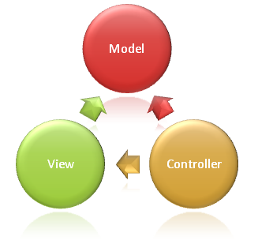
ASP.NET Core MVC
Overview

Slide 18

ASP.NET Core MVC Overview
ASP.NET Core MVC provides features for building web APIs and web apps
Uses the Model-View-Controller (MVC) design pattern
Lightweight, open source, testable, good tooling
Razor markup for Razor Pages and MVC views
RESTful services with ASP.NET Core Web API
Built-in support for multiple data formats, content negotiation and CORS
Achieve high-quality architecture design, optimizing developer work
Convention over Configuration
Model binding automatically maps data from HTTP requests
Model validation with client-side and server-side validation
Often combined with Entity Framework for ORM

Slide 19

ASP.NET Core MVC Features
Routing for mapping requests
Dependency injection for injecting components at runtime
Strongly-typed views with the Razor view engine
Model binding automatically maps data from HTTP requests
Model validation with client-side and server-side validation
Tag helpers enable server-side code in HTML elements
Filters, Areas, Middlewares
Built-in security features
Identity with users and roles
And many more…

Slide 20
The MVC Pattern for Web
HTTP Request
ASP.NET Core (routing + middlewares)
/Some/Page/
Delegate request
User
Controller
(action)
HTTP Response
CRUD model
Select view & pass data
Razor View
(render UI)
Model (data)
Use model data

Slide 21
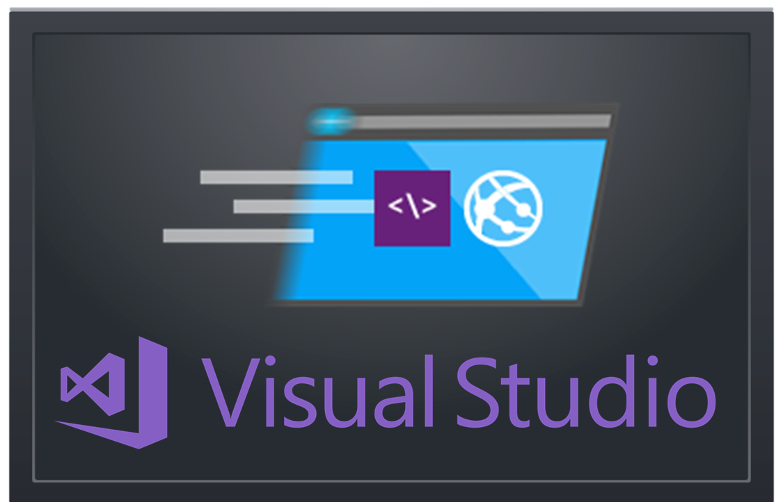
Creating an ASP.NET Core MVC App
Project Setup in Visual Studio. What’s Inside?

Slide 22
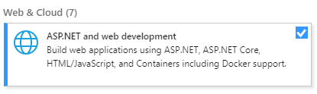
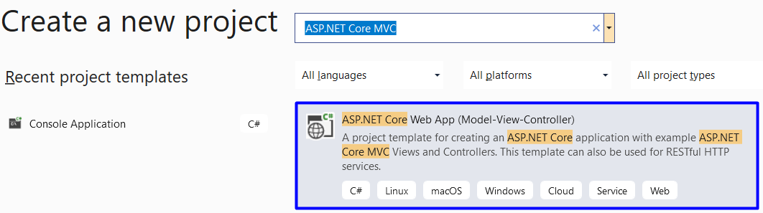
Create ASP.NET MVC App Project
Install this in Visual Studio!

Slide 23
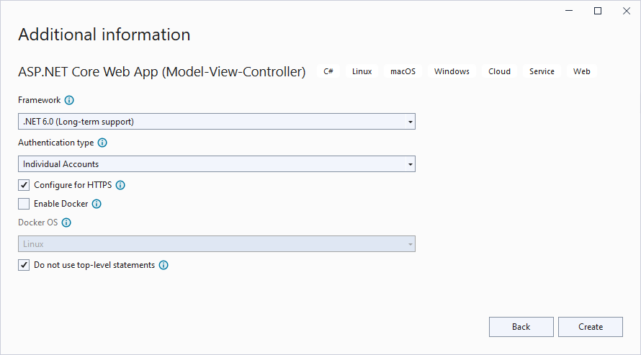
Create ASP.NET MVC App: Choose Template
Choose the .NET version
Add a user account functionality
Enables real-time UI changes to be compiled without restarting your app

Slide 24
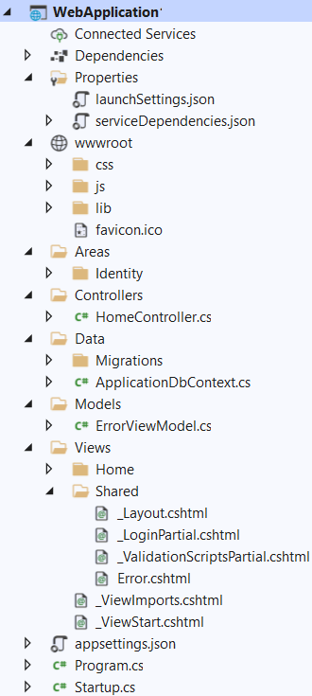
MVC App: What's Inside?
Static files: CSS styles images, fonts, …
NuGet packages
Areas: physically partition a web app in separate units
Controller classes holding actions
Data: EF models + DB context + migrations
Views: HTML templates for the pages
Models: view models
Shared views: layout for all pages + partial views
App start files

Slide 25
Controllers
MVC controllers hold logic to process user actions
The URL /Home/About invokes HomeController → About()
\Controllers\HomeController.cs
public class HomeController : Controller
{
public ActionResult About()
{
ViewBag.Message = "This is an ASP.NET Core MVC app.";
return View();
}
}
Renders \Views\Home\About.cshtml

Slide 26
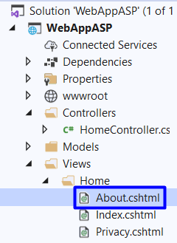

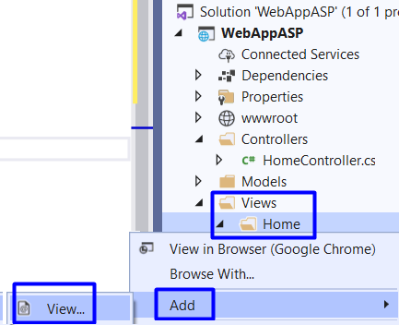
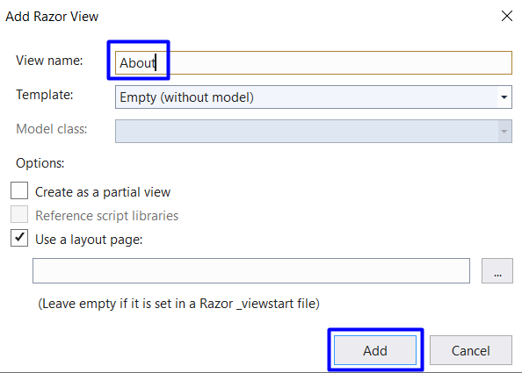
Views (1)
Views render the HTML code for the invoked action
Create About.cshtml view

Slide 27
Views (2)
ASP.NET MVC uses Razor view engine
Views combine HTML with C# code
\Views\Home\About.cshtml
@{
ViewBag.Title = "About";
}
<h2>@ViewBag.Title</h2>
<h3>@ViewBag.Message</h3>
<p>Use this area to provide additional information.</p>
@ { … } inserts C# code block
@Something prints a C# variable
Everything else is HTML code

Slide 28
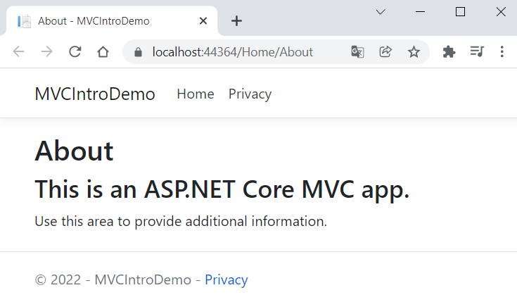
The "About" Page in the Browser
The port number is auto-generated
Run the app, by pressing [Ctrl + F5]
Open the "About" page on https://localhost:44364/Home/About:

Slide 29

Controllers and Actions

Slide 30
Controllers
All controllers should be in the "Controllers" folder
Controller naming standard should be {name}Controller
Every controller should inherit the Controller class
Access to Request, Response, HttpContext, RouteData, TempData, etc.
Routes select Controllers in every request
\Controllers\UsersController.cs
public class UsersController : Controller
{
public IActionResult All() => View();
}
Mapped to URL "/Users/All"

Slide 31
Actions
Actions are the ultimate Request destination
Public controller methods
Non-static
No return value restrictions
Actions typically return an IActionResult
public IActionResult Details(int id)
{
var viewModel = this.dataService.GetById(id).To<DetailsViewModel>();
return this.View(viewModel);
}

Slide 32
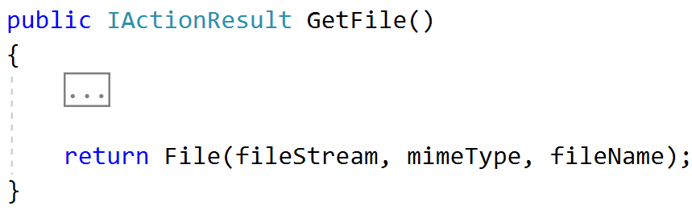
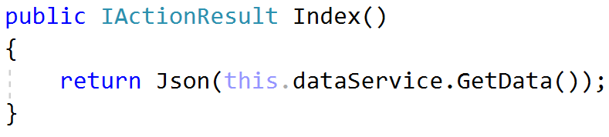
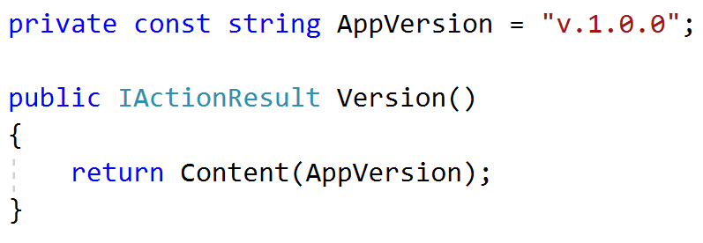
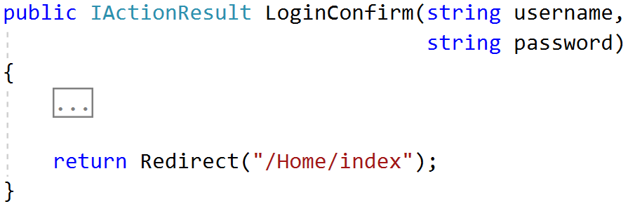
Action Results (1)
Action result == controller's response to a browser request
Represent various HTTP status codes
Inherit from the base ActionResult class

Slide 33
Action Results (2)
Name | Framework Behavior | Helping Method
StatusCodeResult | Returns an HTTP Response Result with given Status | StatusCode() / Ok() BadRequest() / NotFound()
JsonResult | Returns data in JSON format | Json()
RedirectResult | Redirects the client to a new URL | Redirect() / RedirectPermanent()
RedirectToRouteResult | Redirect to another action, or another controller’s action | RedirectToRoute() / RedirectToAction()
ViewResult PartialViewResult | Response is the responsibility of a view engine | View() / PartialView()
ContentResult | Returns a string literal | Content()
EmptyResult | No response, no content-type header
FileContentResult FilePathResult FileStreamResult | Return the contents of a file | File() / PhysicalFile()

Slide 34
Action Selectors
ActionName(string name)
AcceptVerbs
HttpPost
HttpGet
HttpDelete
HttpOptions
…
NonAction
RequireHttps
etc.
public class UsersController : Controller
{
[ActionName("UserLogin")]
[HttpPost]
[RequireHttps]
public IActionResult Login(
string username, string password)
{
return Content("Logged in!");
}
}
Selectors' order doesn't matter

Slide 35

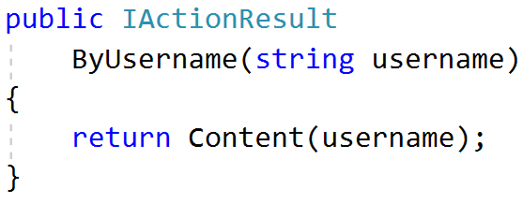
Action Parameters
ASP.NET Core maps the data from the HTTP request to action parameters in few ways:
Routing engine can pass parameters to actions
Routing pattern: Users/{username}
URL query string can contain parameters
/Users/ByUsername?username=NikolayIT
HTTP post data can also contain parameters

Slide 36
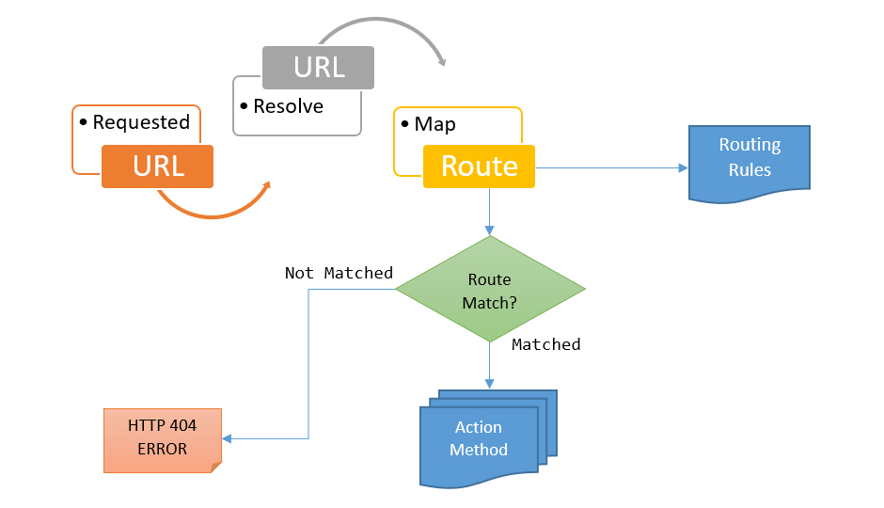
ASP.NET Core MVC Routing

Slide 37
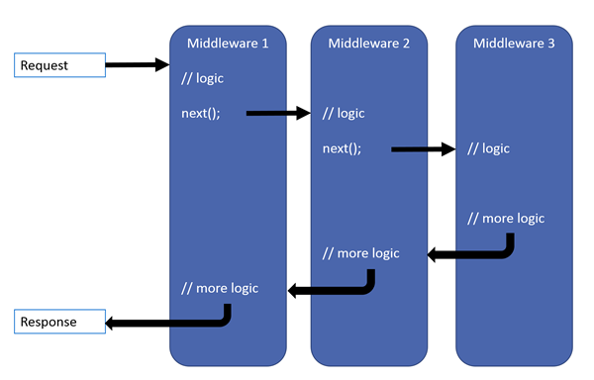

ASP.NET Core MVC Routing
ASP.NET Core MVC uses a middleware for Routing on client requests.
Routes describe how request URL paths should be mapped to Controller Actions.
There are 2 types of Action routing
Conventional
Attribute

Slide 38
Conventional Routing (Used by Default)
Called Conventional because it establishes a convention for URL paths.
public void Configure(IApplicationBuilder app, IHostingEnvironment env)
{
app.UseEndPoints(routes =>
{
routes.MapControllerRoute(
name: "default",
template: "{controller=Home}/{action=Index}/{id?}");
});
}
Will match a route like "/Cats/Show/1"
Will extract the route values:
{ controller = "Cats",
action = "Show",
id = "1" }

Slide 39
Route Constraints
Route Constraints are rules on the URL segments
All the constraints are regular expression compatible with the Regex class
endpoints.MapControllerRoute(
name: "blog",
pattern: "{year}/{month}/{day}",
defaults: new { controller = "Blog", action = "ByDate" },
constraints: new { year = @"\d{4}", month = @"\d{1,2}", day = @"\d{1,2}" }
);
class BlogController : Controller {
public IActionResult ByDate(
string year, string month, string day)
{ … }
}

Slide 40
Attribute Routing
It uses a set of attributes to map actions directly to route template
It can also directly define the request method
Http{Action} attributes are quite often used in REST APIs
public class HomeController : Controller
{
[Route("/")]
public IActionResult Index() => View();
}
public class HomeController : Controller
{
[HttpGet("/")]
public IActionResult Index() => View();
}
public class UsersController : Controller
{
[HttpPost("Login")]
public IActionResult Login() => View();
}

Slide 41
Attribute Routing (2)
Attribute routing allows you to create multiple routes for a single action
It also allows you to combine a route for a controller and an action route
[Route("Home")]
public class HomeController : Controller
{
// …
[Route("/")] // Does not combine, Route – /
[Route("Index")] // Route - /Home/Index
[Route("")] // Route - /Home
public IActionResult Index()
{
return View();
}
}
public class HomeController : Controller
{
// …
[Route("/")]
[Route("Index")]
public IActionResult Index()
{
return View();
}
}

Slide 42
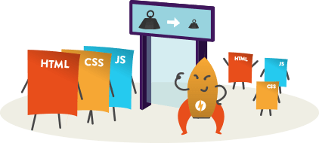
Static File Routing

Slide 43
Static Files (1)
Static files are a necessity for a web application to work
Files such as HTML, CSS, JS and different Assets can be served directly to Clients with ASP.NET Core
public void Configure(IApplicationBuilder app, IHostingEnvironment env)
{
app.UseStaticFiles();
}
This will tell the ASP.NET Core App to serve the static files in the "wwwroot" directory

Slide 44
Static Files (2)
Can be modified to serve other folders
public void Configure(IApplicationBuilder app, IHostingEnvironment env)
{
app.UseStaticFiles(
new StaticFileOptions()
{
FileProvider = new PhysicalFileProvider(
Path.Combine(Directory.GetCurrentDirectory(), "OtherFiles")),
RequestPath = new PathString("/files")
});
}
This will serve "style.css" file upon request "http://{app}/files/style.css" from "OtherFiles" instead of "wwwroot"

Slide 45

Views and Razor View Engine
Passing Data to a View

Slide 46
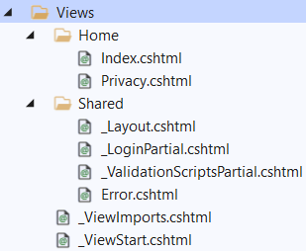
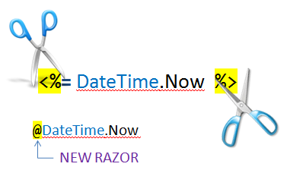
Views
Views render the HTML code for the invoked action
View naming standard is {ActionName}.cshtml
Views should be placed in folder "/Views/{ControllerName}"
A lot of view engines available
View engines execute code and provide HTML
Provide a lot of helpers to easily generate HTML
The most popular is Razor View Engine

Slide 47
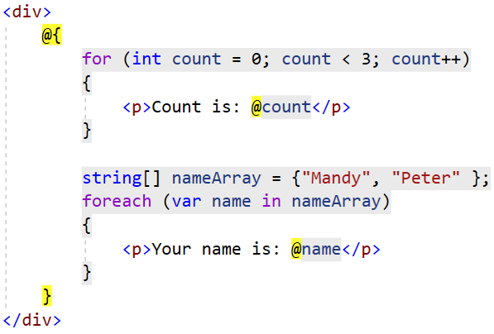
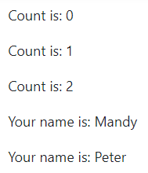
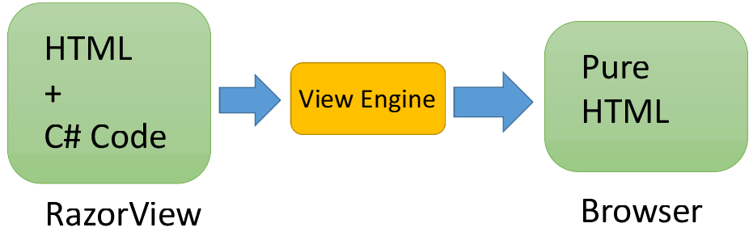
Razor View Engine
Razor is a markup syntax which helps us write HTML and server-side code using C#
Razor View Engine: use Razor with MVC to produce HTML
Code blocks start with a @ character and don't require explicit closing

Slide 48
Razor View Engine: Example
HTML mixed with C# code (@ switches to C#):
<div class="row">
@foreach(var article in Model)
{
<article>
<h2>@article.Title</h2>
<p>@article.Content</p>
<small>--@article.Author.FullName</small>
</article>
}
</div>
C# foreach
C# code
HTML
Syntax
C# code

Slide 49
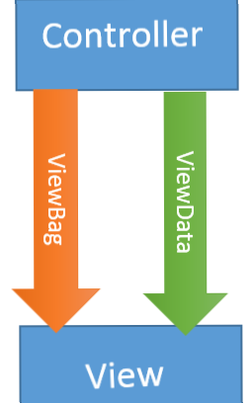
Passing Data to a View
With ViewBag (dynamic type):
Action: ViewBag.Message = "Hello World!";
View: @ViewBag.Message
With ViewData (dictionary)
Action: ViewData["message"] = "Hello World!";
View: @ViewData["message"]
With Strongly-typed views
Action: return View(model);
View: @model ModelDataType;

Slide 50
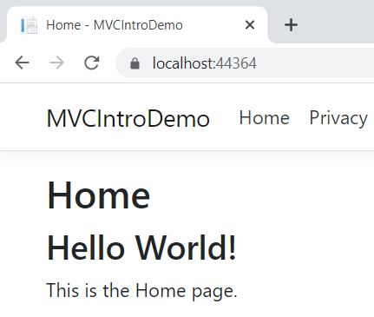
ViewBag – Example
\Controllers\HomeController.cs
public IActionResult Index()
{
ViewBag.Message = "Hello World!";
return View();
}
\Views\Home\Index.cshtml
@{ … } inserts C# code block
@{
ViewBag.Title = "Home";
}
<h2>@ViewBag.Title</h2>
<h3>@ViewBag.Message</h3>
<p>This is the Home page.</p>
@Something prints a C# variable
Everything else is HTML code

Slide 51
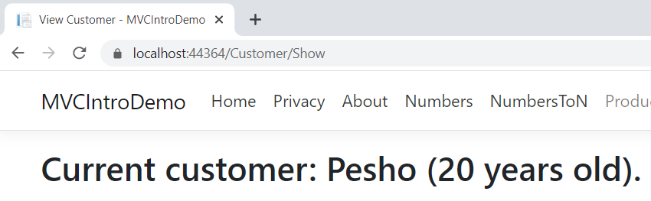
Strongly-Typed View – Example
\Controllers\CustomerController.cs
\Models\CustomerViewModel.cs
public IActionResult Show()
{
CustomerViewModel customer =
new CustomerViewModel()
{
Name = "Pesho",
Age = 20
};
return View(customer);
}
public class CustomerViewModel
{
public string Name { get; set; }
public int Age { get; set; }
}
The @model directive makes the model available to the view
\Views\Customer\Show.cshtml
@model CustomerViewModel
@{ViewBag.Title = "View Customer";}
<h2>Current customer: @Model.Name
(@Model.Age years old).</h2>
@Model.Property prints a model property

Slide 52
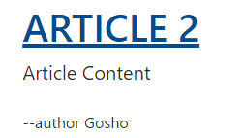
HTML Helpers: Example
We can use HTML helpers in Razor to generate HTML:
@Html.ActionLink(
article.Title,
"Details",
"Article",
new {
id = article.Id
},
new {
@class = "text-uppercase"
}
)
Link text
<a class="text-uppercase"
href="/Article/Details/2">
Article 2
</a>
HTML Result
Action
Controller
Controller Route Values
HTML Attributes

Slide 53

Dependency Injection
Overview

Slide 54
What is Dependency Injection?
Dependency injection injects objects at runtime
Register some service class in the Startup class:
Later, inject the registered class in your controllers
public void ConfigureServices(IServiceCollection services)
{
services.AddTransient<DataService>();
}
public class ProductController : Controller
{
public ProductController(DataService ds) {
// Use the injected object "ds"
}
}

Slide 55

Model Binding

Slide 56
Model Binding (1)
Model binding in ASP.NET Core MVC maps data from HTTP requests to action method parameters.
The parameters may be primitive types or complex types
Implemented abstractly, paving the way for reusability in different apps
The framework binds request data to action parameters by name
The value of each parameter will be searched, using the parameter name
Classes are mapped using the names of the public settable properties
Request URL
PostsController
https://mysite.com/posts/edit/6
public IActionResult Edit(int? id)

Slide 57
Model Binding (2)
Model binding can look through several data sources per Request
Form values – POST Request parameters
Route values – The set of Route values provided by the Routing
Query strings – The query string parameters in the URL
Even in headers, cookies, session, etc. in custom model binders
Data from these sources are stored as name-value pairs
The framework checks each of the data sources for a parameter value
If there is no parameter in the data source, the next in order is checked
The data sources are checked in the order specified above

Slide 58
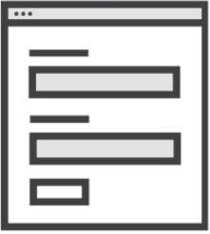
Incoming Request to MVC
Populate
Model State
Instance Created
by Model Binder
Model Binder
Validation
public MyController : Controller {
IActionResult Index(MyInputModel input)
{
if (ModelState.IsValid)
{
return View();
}
}
}
MyInputModel instance

Slide 59
Model Binding (3)
If binding fails, the framework does not throw an error
Every action, accepting user input, should check if binding was successful
This is done through the ModelState.IsValid property
Each entry in the controller's ModelState property is a ModelStateEntry
Each ModelStateEntry contains an Errors property
It's rarely necessary to query this collection, though
Default Model binding works great for most development scenarios
It is also extensible, and you can customize the built-in behavior

Slide 60



Model Binding (4)
You can easily iterate over the errors in the ModelState
public class UsersController : Controller
{
public IActionResult Register(RegisterUserBindingModel model)
{
if(!ModelState.IsValid)
{
foreach (var error in ModelState.Values.SelectMany(v => v.Errors))
{
DoSomething(error);
}
// TODO: Return Error Page
}
return Ok("Success!");
}
}

Slide 61
Model Binding (5)
Built-in Model binding behavior can be directed to a different source
The framework provides several attributes for that
Attribute | Description
[BindRequired] | Adds a model state error if binding cannot occur.
[BindNever] | Tells the model binder to never bind this parameter.
[From{source}] | Used to specify the exact binding source. [FromHeader], [FromQuery], [FromRoute], [FromForm]
[FromServices] | Uses dependency injection to bind parameters from services.
[FromBody] | Use configure formatters to bind data from request body. Formatter is selected based on Content-Type of Request.
[ModelBinder] | Used to override the default model binder, binding source and name.

Slide 62



Model Validation

Slide 63
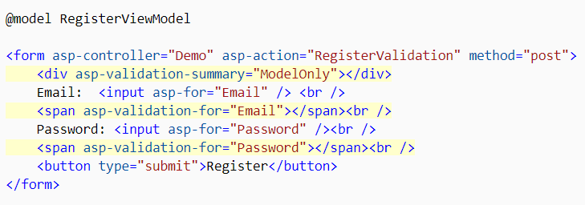
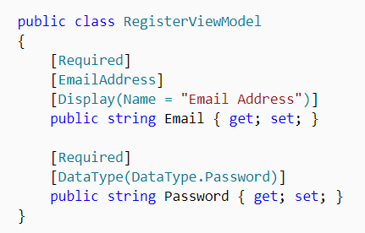
Model Validation (1)
Validation is absolutely necessary before persisting data
There may be potential security threats
There may be malformed data (type, size, data constraints)
In ASP.NET Core MVC, validation happens both on client and server

Slide 64


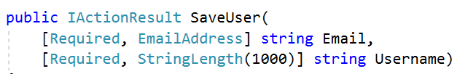
Model Validation (2)
.NET provides us an abstracted validation through attributes
Some attributes configure model validation by constraint
Similar to validation on database fields
Other apply patterns to data to enforce business rules
Credit Cards, Phone Numbers, Email Addresses etc.
Validation attributes make enforcing these requirements simple
They are specified at the property or parameter level

Slide 65
Model Validation (3)
Some of the most popular built-in validation attributes are:
Attribute | Description
[CreditCard] | Validates the property has a credit card format
[Compare] | Validates 2 properties in a model match. (Useful for password confirmation)
[EmailAddress] | Validates the property has an email format.
[Phone] | Validates the property has a telephone format.
[Range] | Validates the property value falls within the given range.
[RegularExpression] | Validates the data matches the specified regular expression.
[Required] | Makes the property required. Value cannot be null.
[StringLength] | Validates that a string property has at most the given maximum length.
[Url] | Validates the property has a URL format.

Slide 66
Incoming Request to MVC
Can you create a Model Binder
for MyInputModel?
IActionResult Index(MyInputModel input) {
return View();
}
Validation
ModelBinderProvider 1
Sorry, can't create a Model Binder for that
Value Providers
Default
Route
URL Query
FormData
ModelBinderProvider 2
Model Binder
Yes, I can, here you go
Input Formatters
Will never be checked
[FormBody] (if applicable)
JSON
XML
ModelBinderProvider 3

Slide 67

Summary
…
…
…
ASP.NET Core is a great platform for developing Web apps
MVC Controllers and Actions
MVC Views and Razor
Routing
Static Files
Dependency Injection
Model Binding and Model Validation

Slide 68
Questions?
Notes:
68

Slide 69
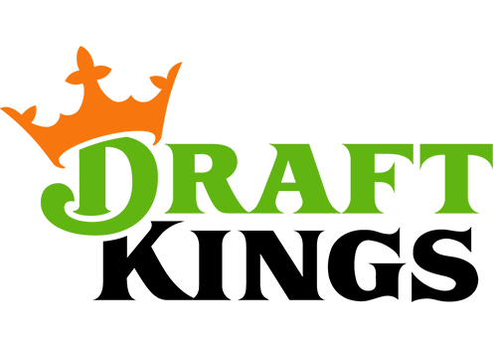

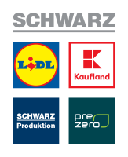










SoftUni Diamond Partners

Slide 70

Educational Partners

Slide 71
Trainings @ Software University (SoftUni)
Software University – High-Quality Education, Profession and Job for Software Developers
softuni.bg, about.softuni.bg
Software University Foundation
softuni.foundation
Software University @ Facebook
facebook.com/SoftwareUniversity
Software University Forums
forum.softuni.bg
Notes:
71

Slide 72

License
This course (slides, examples, demos, exercises, homework, documents, videos and other assets) is copyrighted content
Unauthorized copy, reproduction or use is illegal
© SoftUni – https://about.softuni.bg/
© Software University – https://softuni.bg
Notes:
72

